Slide 1
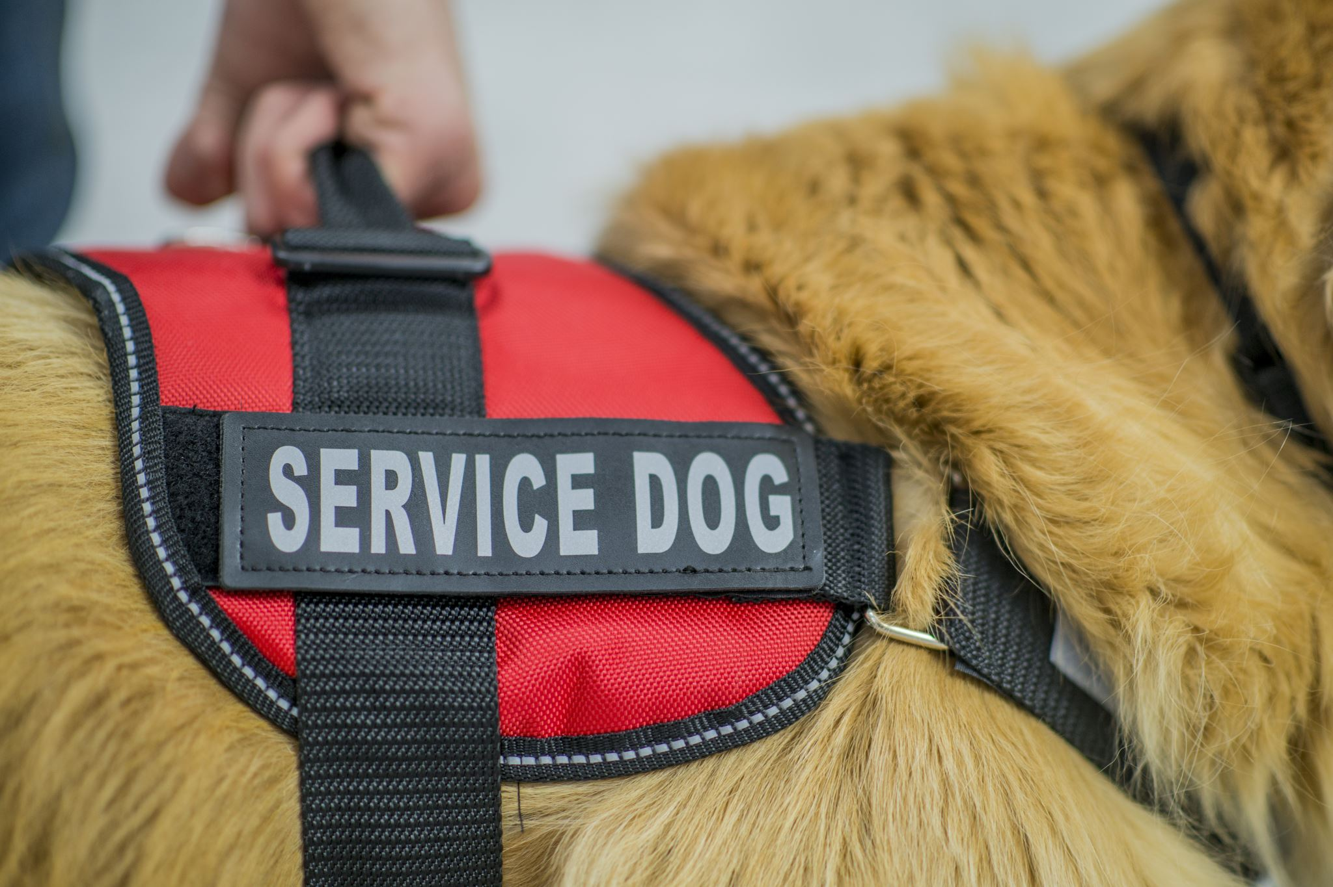
Service Dog Handler App

Slide 2
What is a Service Dog?
A service dog is “a dog that is individually trained to do work or perform tasks for a person with a disability.”
A service dog helps a person with a disability lead a more independent life.
Tasks could include;
Medical Alert
Picking up items off the floor
Mobility support
Service dogs are allowed in any public venue wherever the handler goes, with the exception of where food is processed and produced.
Notes:
In case any member of the student body is not aware what a ‘Service Dog’ is. A brief explanation.

Slide 3
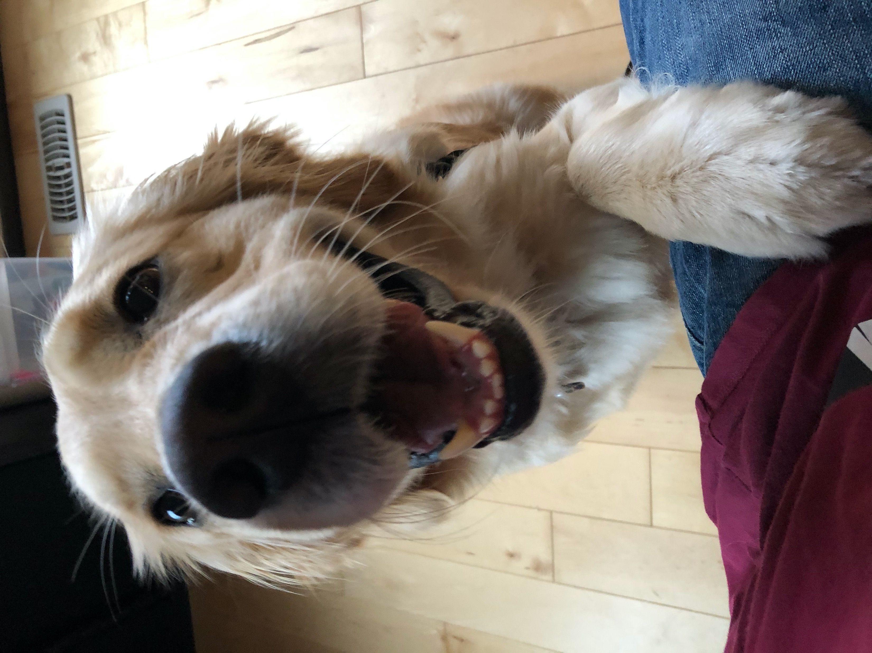
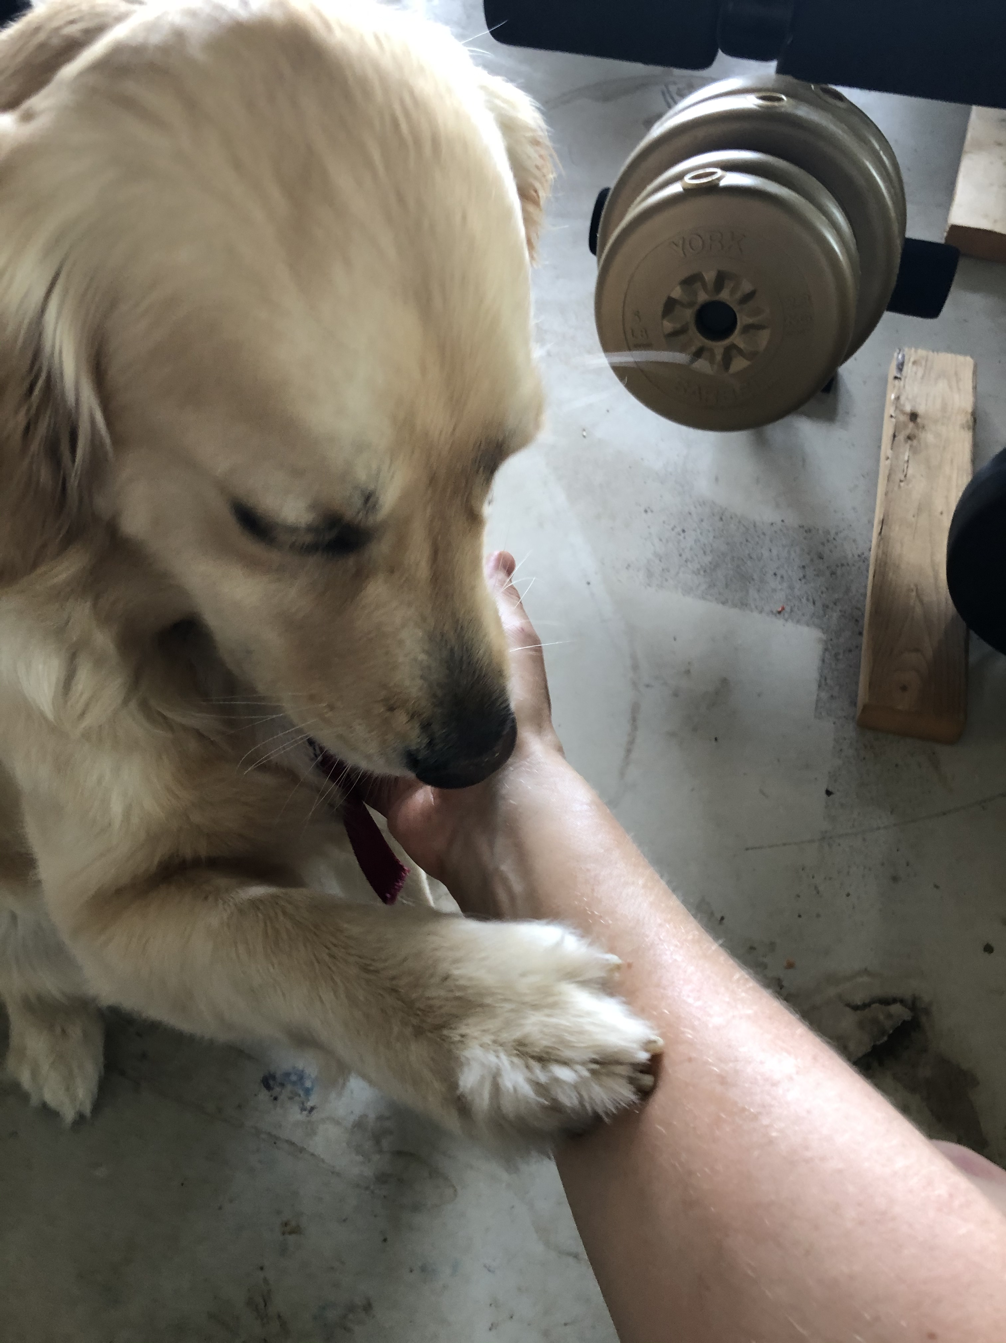
Notes:
This is Echo doing a medical alert

Slide 4
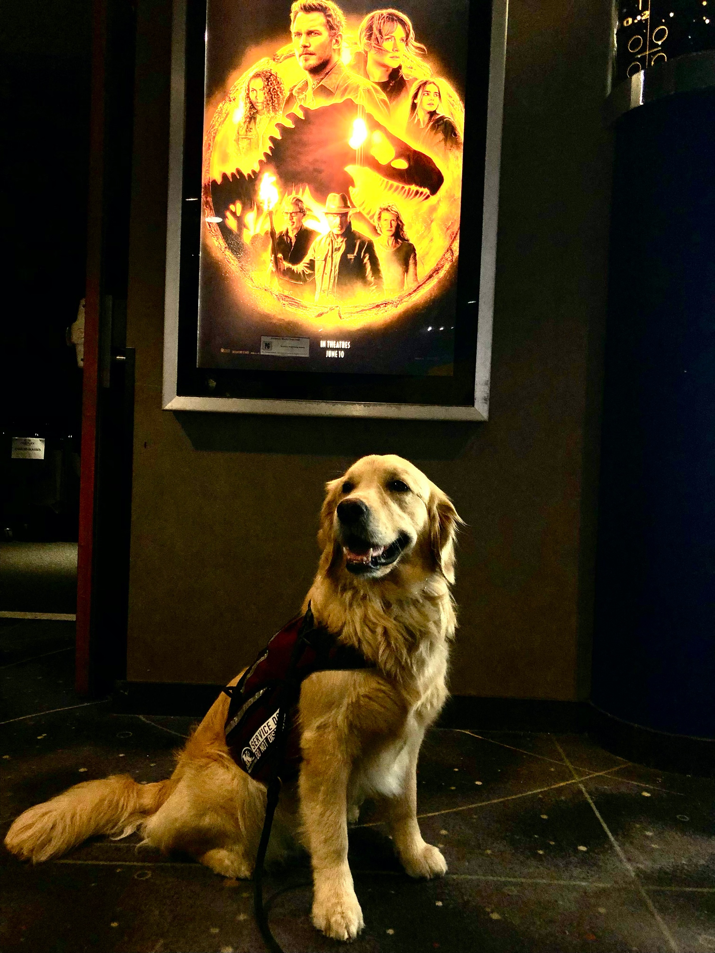
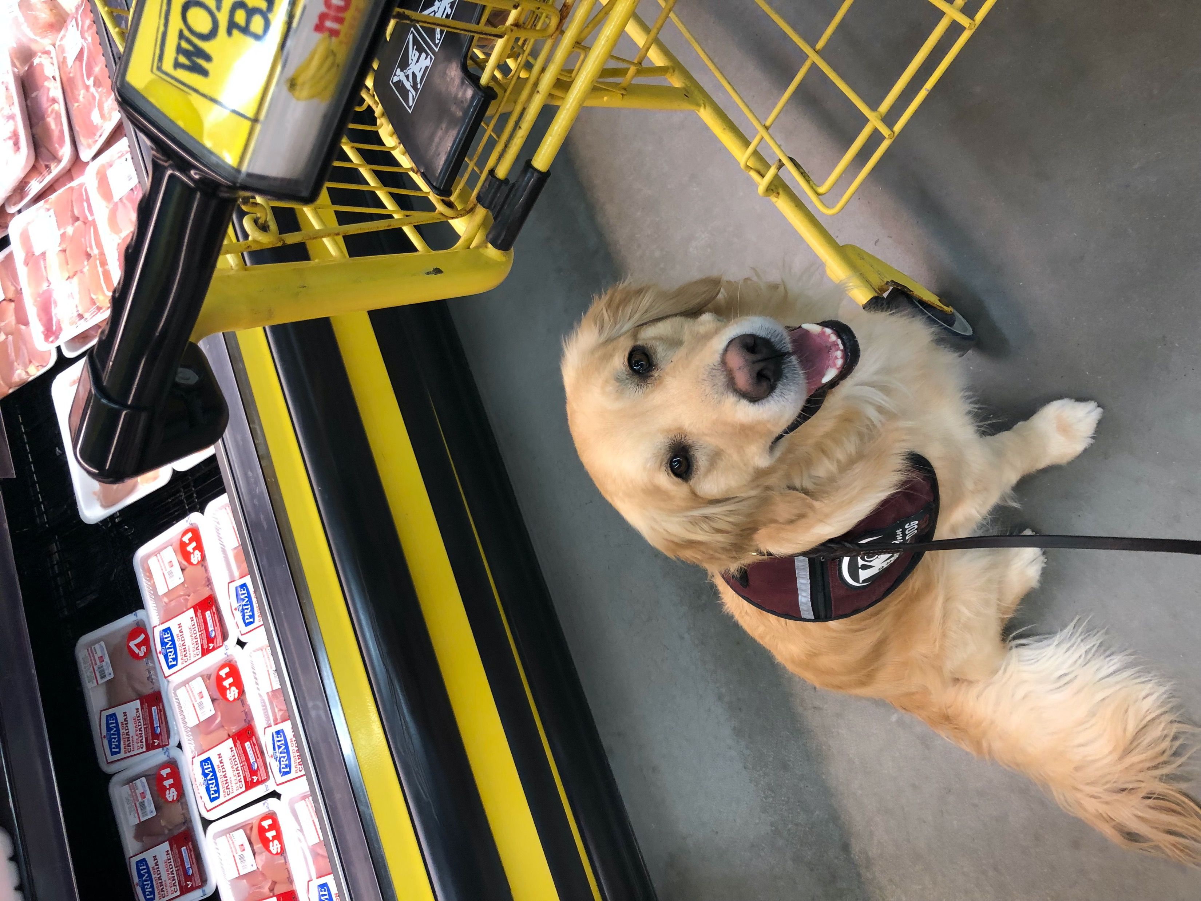
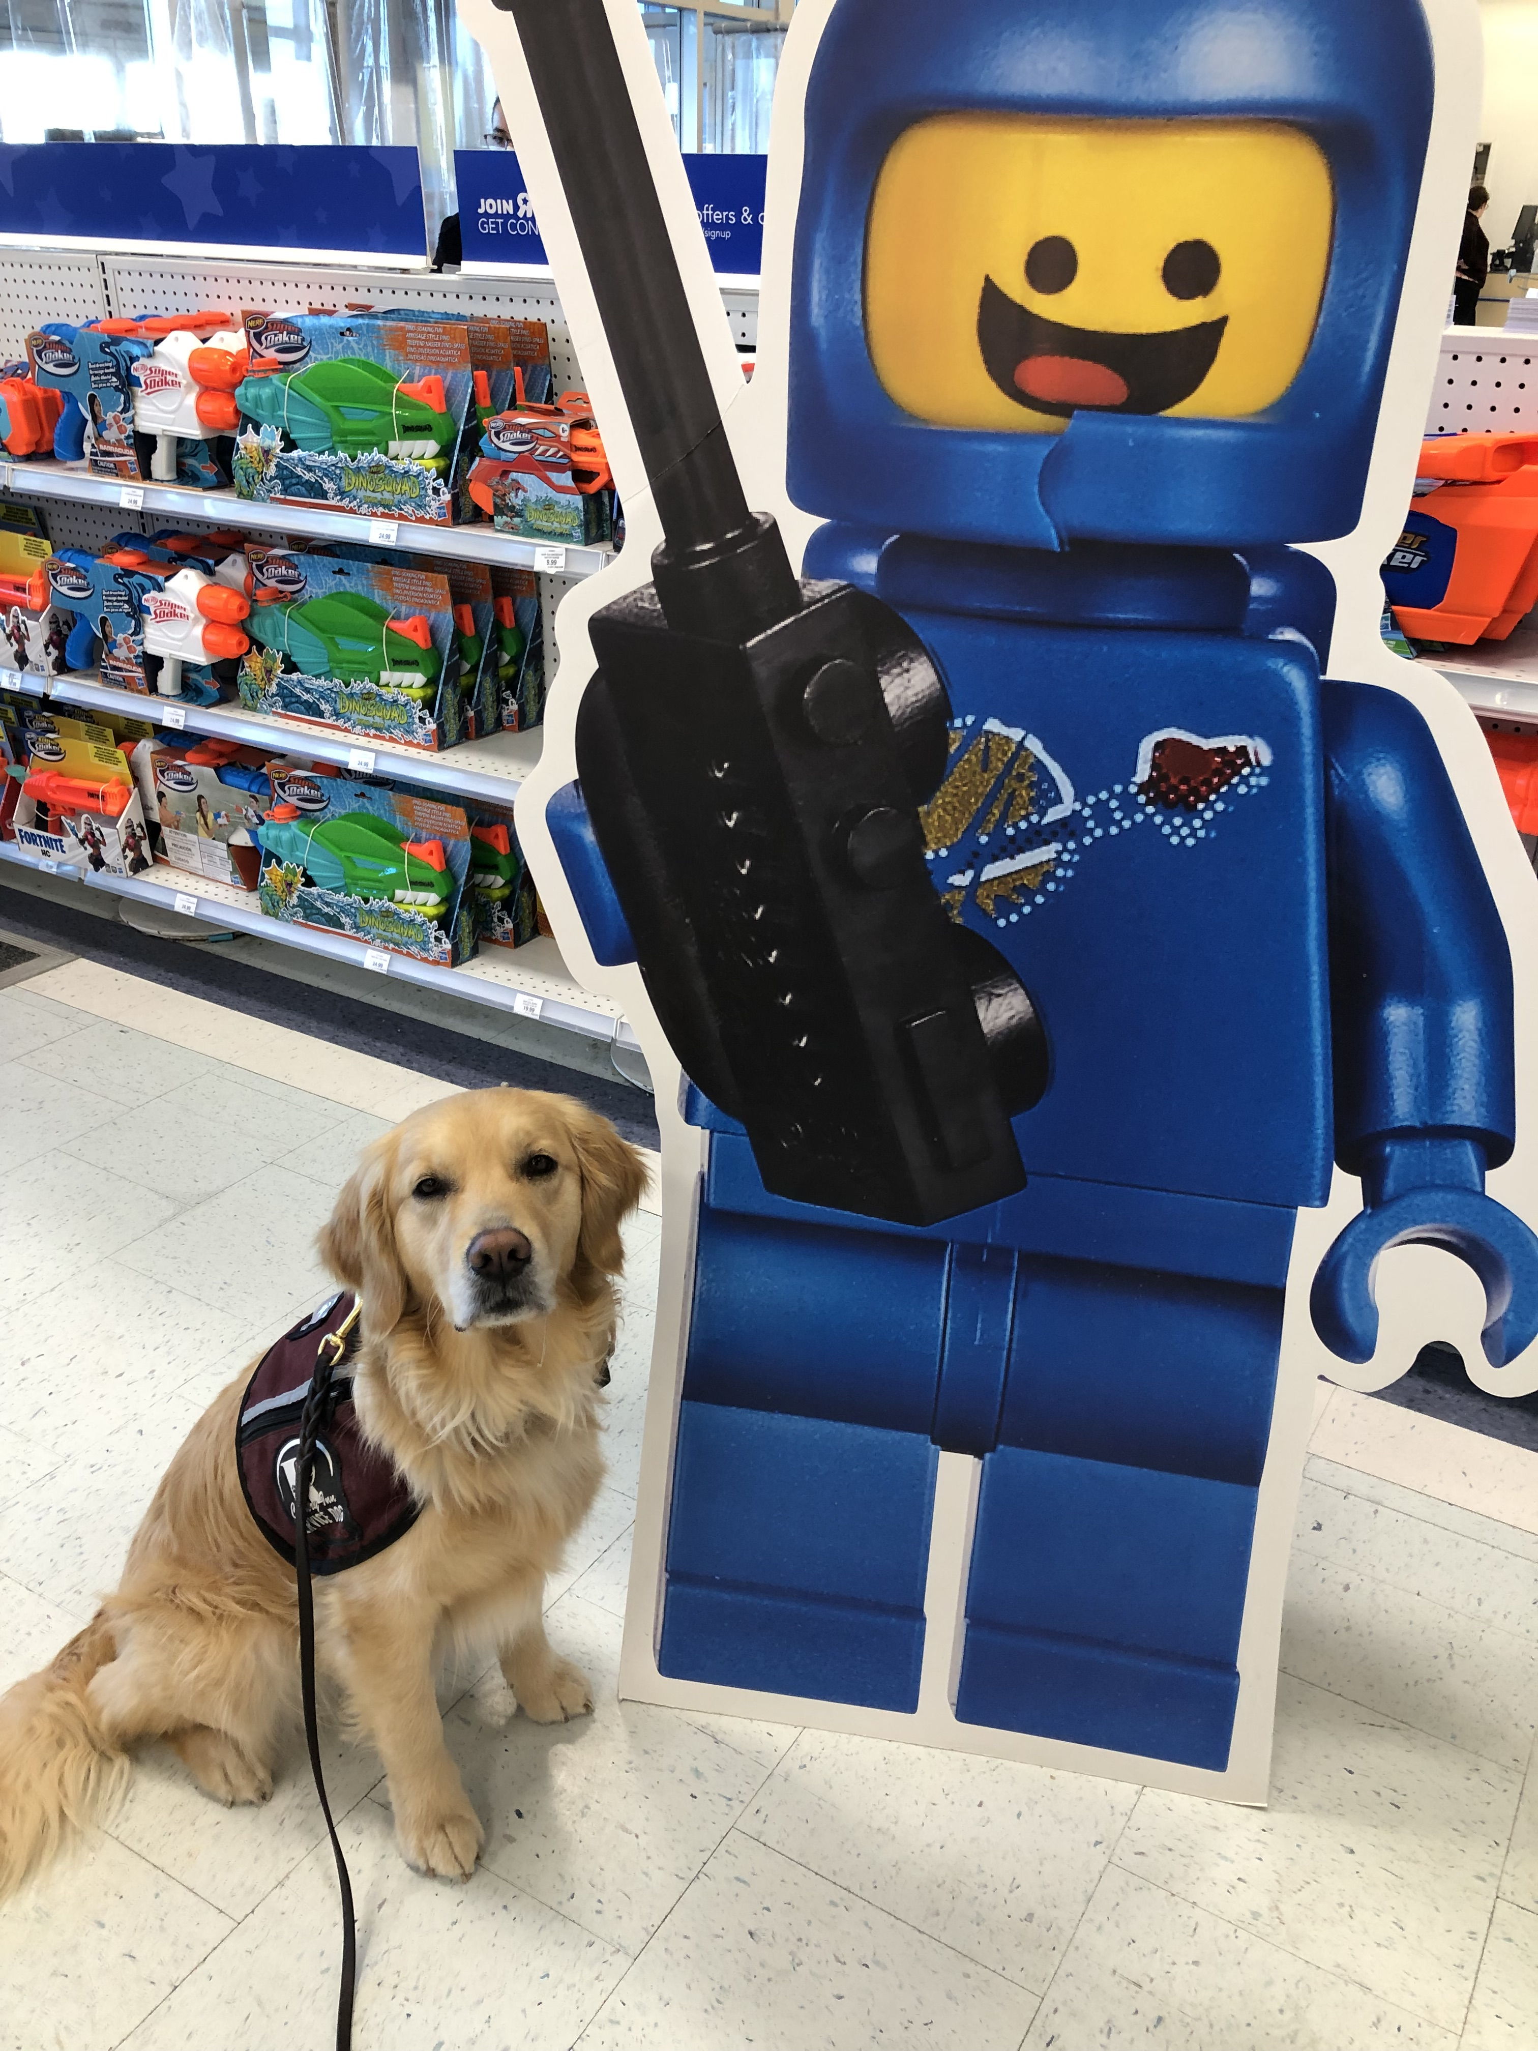
Public Access
Notes:
Service Dogs are allowed to attend locations with their handler. Locations can include – restaurants (eating area – not kitchen), grocery stores, movie theaters, etc.

Slide 5

Service Dog Handler App
What is the purpose?
Are there not lots of dog training apps already?

Slide 6
Purpose of this app?
To help people that own and/or train service dogs
Create a central location that has information readily available
Save service dog agency staff & volunteers time by not having to answer the same questions
Utilize technology
Notes:
The overall purpose of this app is to help people.

Slide 7
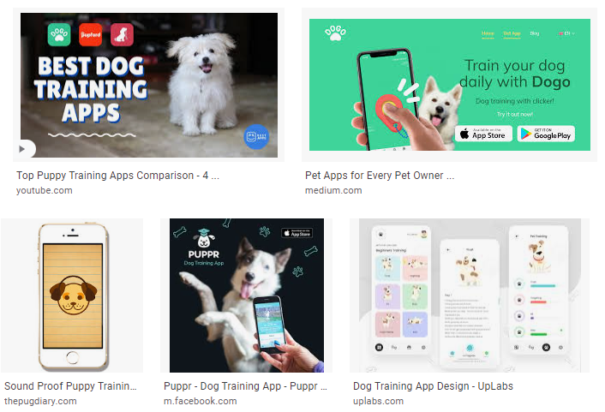
Not a Training App
Notes:
If you check on Apple or Google Play stores, there are lots (especially Google Play store) of dog training apps. I am not looking to create one.

Slide 8
Notes:
Much of the content for the Service Dog Handler App, is what I have learned over my journey and from what others have mentioned. There is A LOT to know. Even most recently, a young new Service Dog handler was asking a training log question on our agency’s group chat. With the amount of information a handler needs to know (remember), binders containing information can become very large. I was told by a treatment provider years ago, technology is here - use it.
I have tried to take a number of categories and consolidate them into (currently) seven.
Health & Wellness
Public Access & Laws
Travel
Training Logs
Expense Logs
Businesses & Services
Settings

Slide 9
Health & Wellness
Pet Insurance
Dog Stages
Public Access & Laws
Provincial & Federal Laws
Public Access kits
Travel
Vehicle Travel
Bus, Taxi, Uber, Train
Pet Health
Do More With Your Dogs
Toys
Obedience to maintain
Public Access Questions & Answers
Out of Province
Hotel
Air Travel
Doctor's Note
Service Dog Certification
Notes:
The first 3 categories are – Health & Wellness, Public Access & Laws, and Travel.
Health & Wellness
I am not looking to re-invent the wheel when it comes to dog Health & Wellness. I’m merely wanting to put general information that will assist service dog owners/handlers along their journey. If an app user were to click on the subsection – Pet Health – they will find subcategories that will include – grooming tips, ideal weight, trimming nails, etc. I would like to be able to include photos and/or links to websites that handlers can visit.

Slide 10
Pet Insurance Options
1
2
3
Owners Three Options;
Do not have to get pet insurance
Take your monthly quote (i.e. - $75/month) an invest in a saving account
Purchase Pet Insurance (numerous companies)
Trupanion
Info & Link
Pet Watch
Info & Link
CAA
Info & Link
Notes:
Another example would be Pet Insurance. I’m not an expert in the insurance industry but have seen many handlers on our group chat asking the questions about getting insurance or not. Having a subcategory related to Pet Insurance would allow the owner/handler to see for themselves what the options are.

Slide 11
Training Log
Obedience training Log
Mileage
Expense Log
Tracking Service Dog expenses
Receipts
Businesses & Services
KONG
Inukshuk
Benebone
RuffLand Kennels
Mileage
Public Access training Log
Chuckit
RC Pets
Mendota
Benny Bully
Hurtta
Ware Pet
Chewmasters
Dog Delights
Ruffwear
Notes:
Three more categories include – Training Logs, Expense Logs and Businesses & Services.
Training Logs and Expense Log will be discussed in a couple of slides.
Businesses & Services listed under this category are trusted companies for owners/handlers to visit in store or online. These businesses provide – pet food, training treats, crates/kennels, clothing, etc. Handlers will also ask on group chats were to buy things. I see these questions every few months when new owners/handlers join the agency chat group.

Slide 12
Businesses & Services (subcategories)
Food
Clothing & Boots
Leash & collars
Sponsors & Specials
Crates & Kennels
Training Treats

Slide 13
Dog Food
Raw
Kibble
Raw
Company & Link
Company & Link
Notes:
The idea is that if an app user selects the ‘Food’ category, they will be given the option of Raw food or Dog kibble. If the user chooses – Raw, they will then see a list of company names and email or company links.

Slide 14



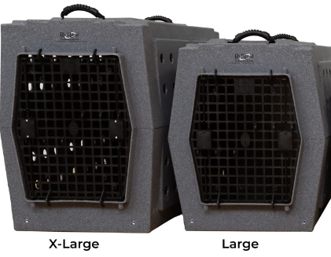



Company Examples

Slide 15
Settings
Log In
Change Password
Expansion
Vet Clinic Info?
Expansion
Trainer Portal?
Alerts
Reminders
Emergency Contacts?
User Profile
Notes:
Hopefully this app could be developed with the availability of expansion slots for future growth.

Slide 16

Key Features of the App
Training Log entries & photographs (videos?)
Expense Tracking (Information & Photograph – PDF of receipts)
Ability for businesses to have general information posted and links direct to websites or deals

Slide 17
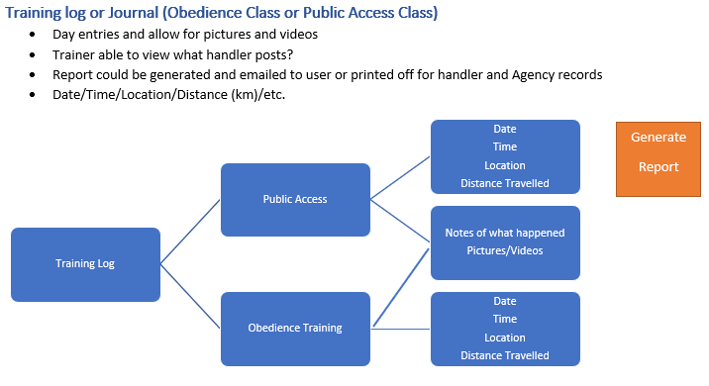
Training Log Details

Slide 18
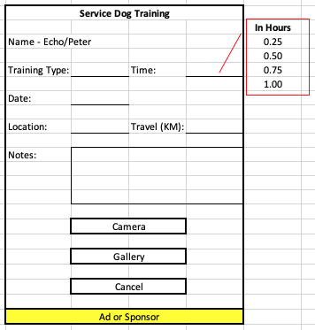
Training Log
Training logs are important for all Service Dog handlers and/or volunteers to have
Reasons;
If training records are ever required in Court proceedings
AODA
Human Rights
Employment
Service Dog certification

Slide 19
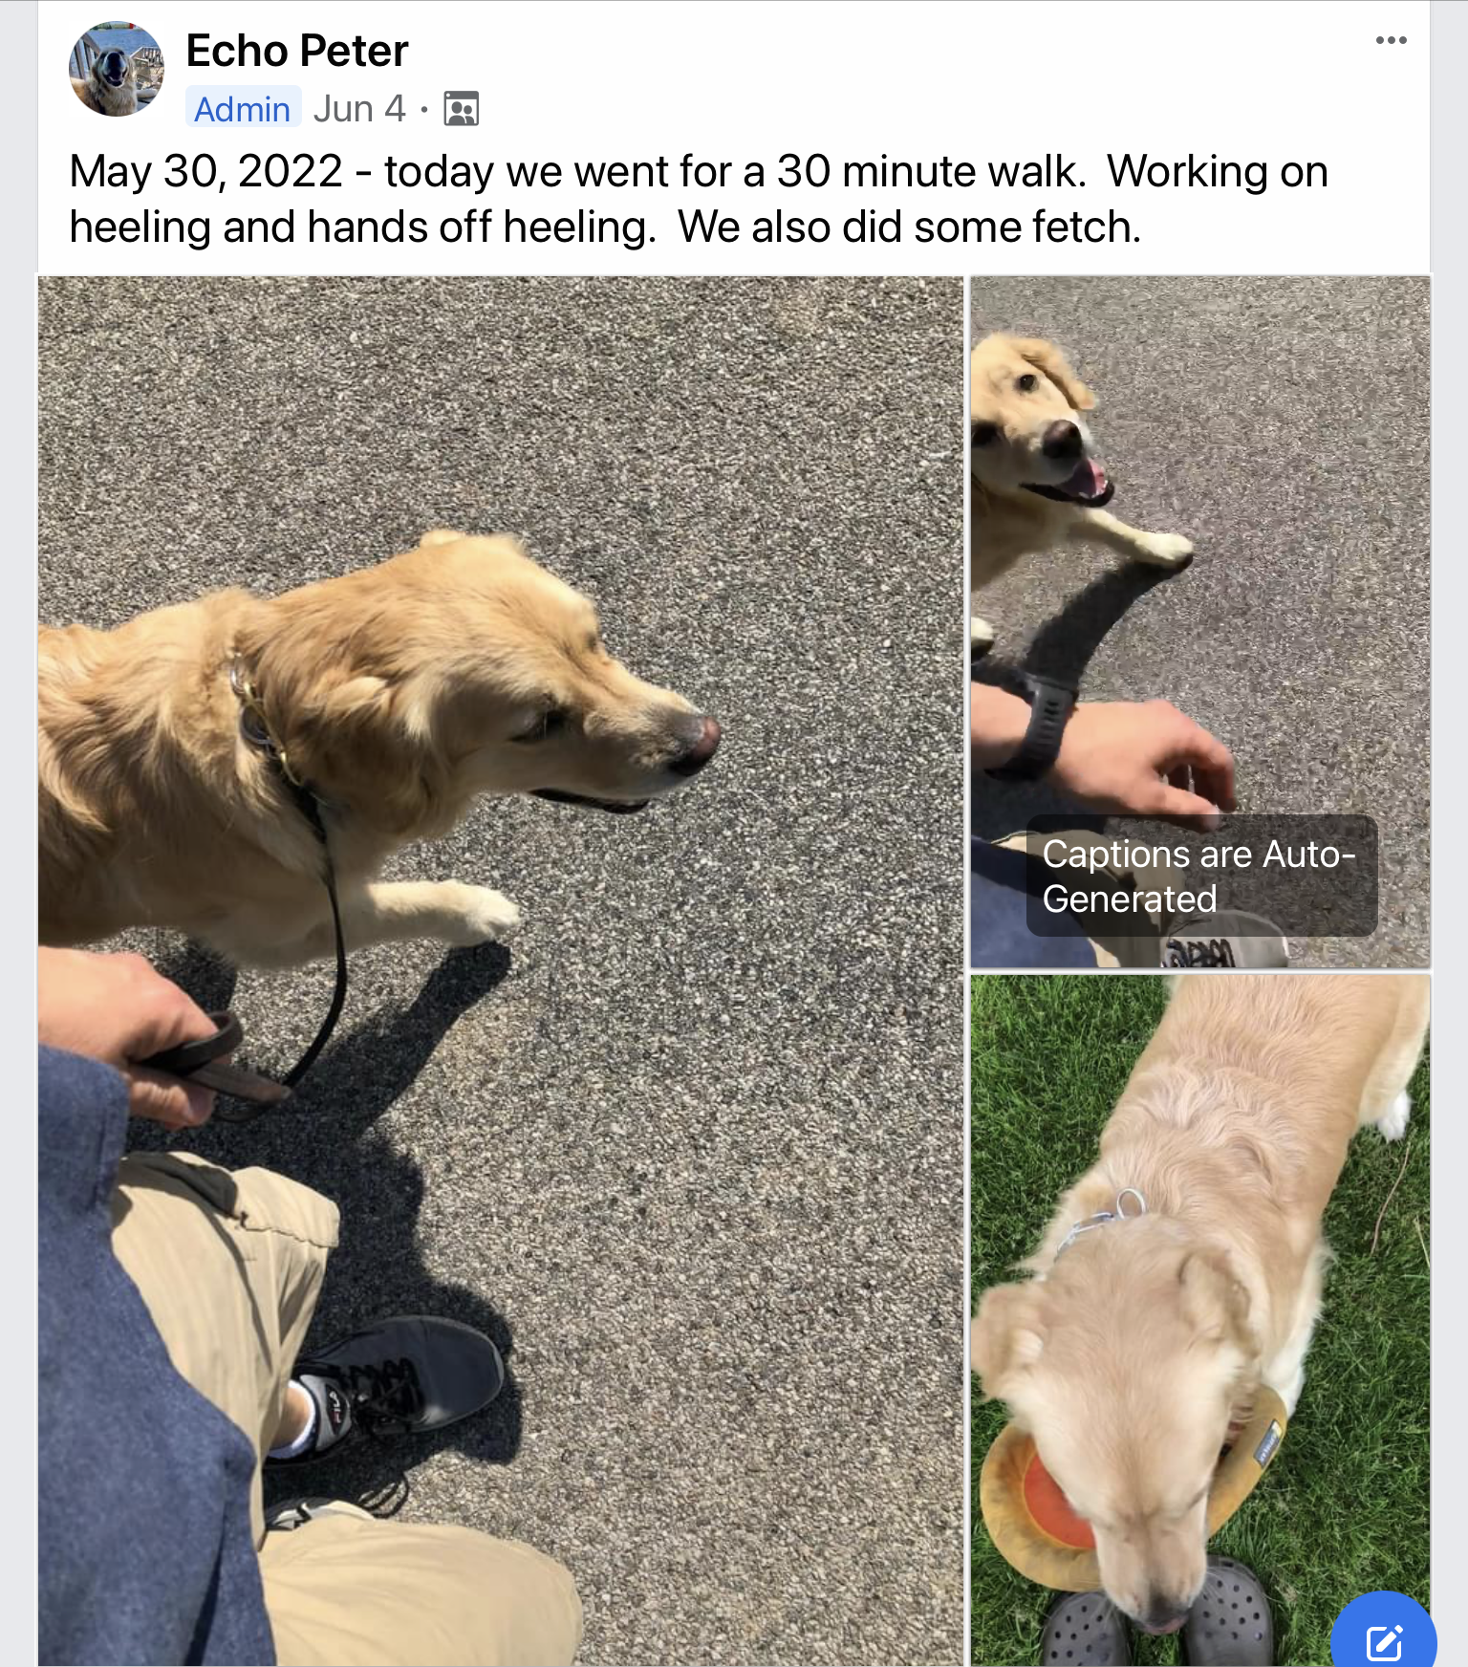
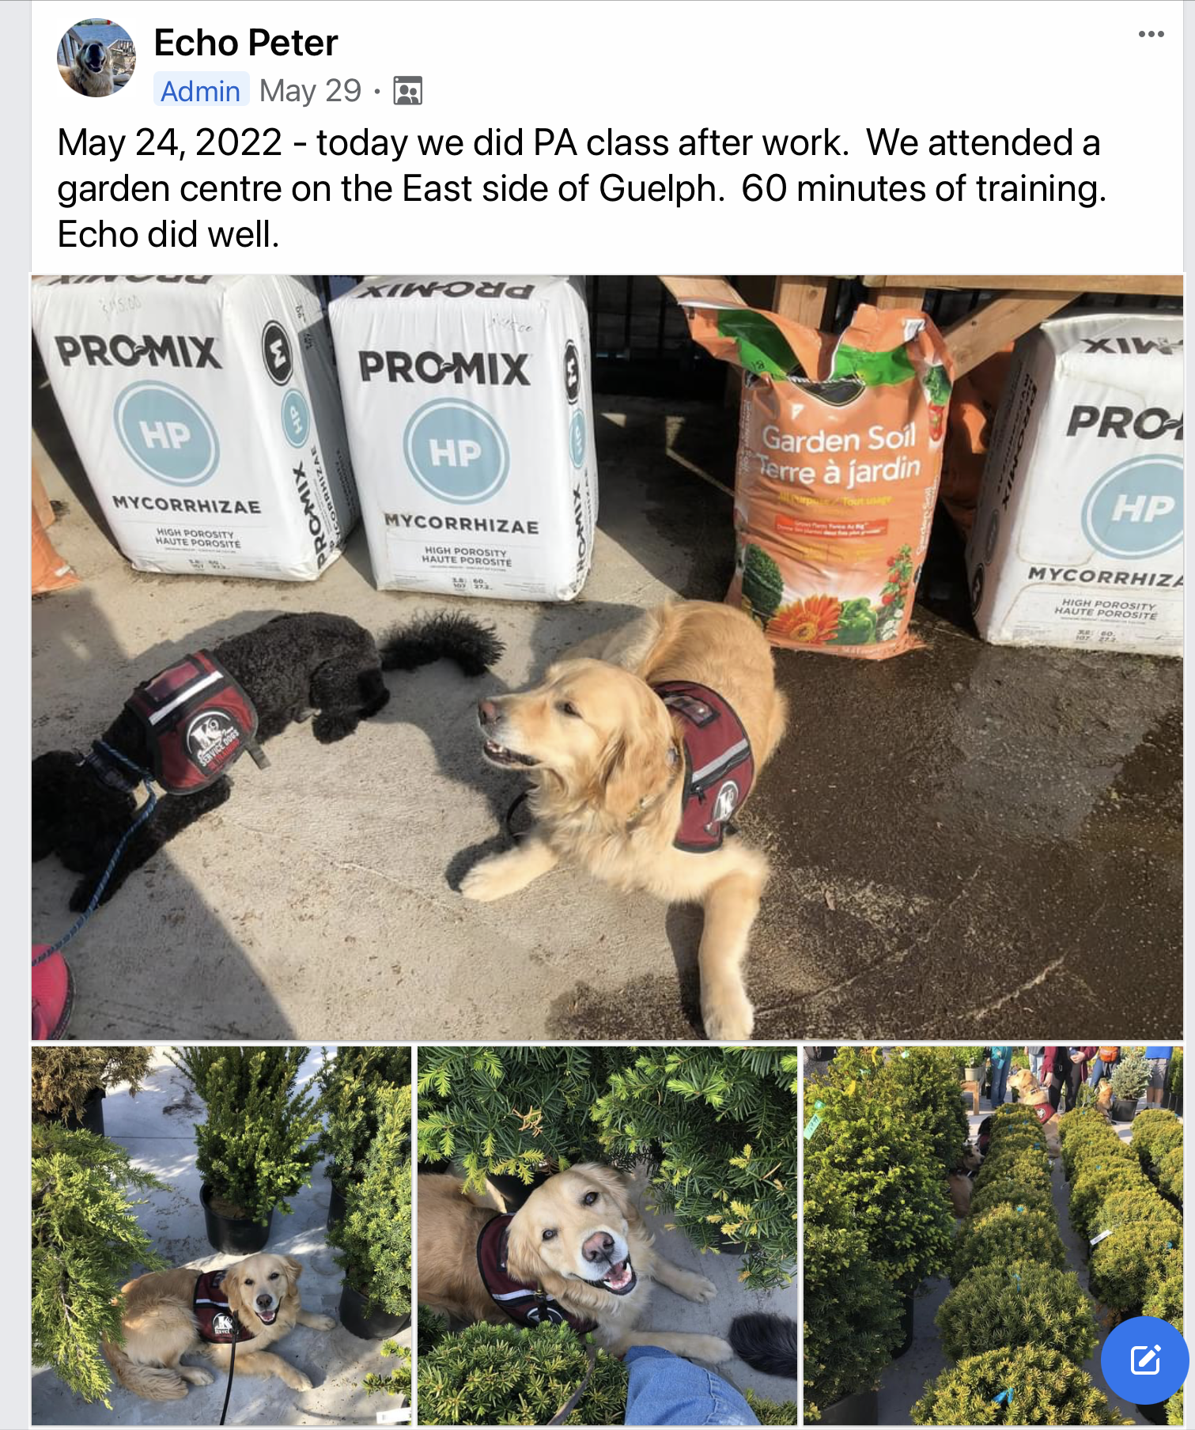
Training Log Information with Images
Notes:
Training Logs – important information for a service dog handler, is noted each time obedience and public access training is done. These records can be used in court if ever needed. Considering different handlers have different disabilities, I struggled to keep book/paper logs. What worked for me was when a Facebook page was created for me. I could post brief comments, pictures and videos of what we did each day. With having short term memory issues, having the photographs of different training opportunities assisted me in making my notes. My service dog trainers were also a part of the Facebook page and could view my comments and pictures.

Slide 20
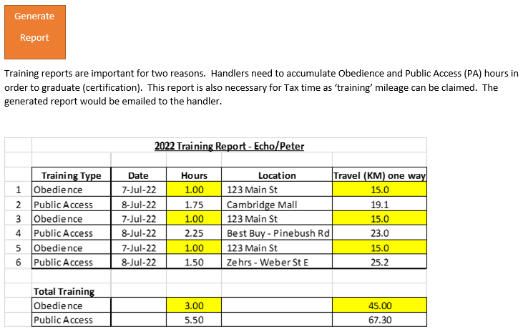
Notes:
Could this report be auto generated once a week (Sunday 11:59pm EST). Or do we leave it up to each handler to remember to click on the ‘Generate Report’ feature to create their own report when ready.

Slide 21
Expense Report

Slide 22
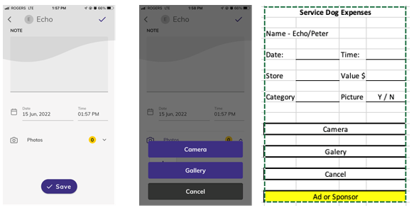
Expense Report

Slide 23
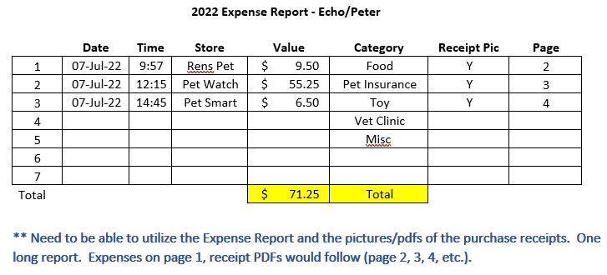
Expense Report

Slide 24
App Sponsor/Advertisement Opportunities
Would pet stores, dog toy/crate developers, & Pet Insurance companies be interested in sponsoring or paying for advertising space on this app?
App Sponsor/Advertisement funds to support;
App maintenance
Security
Updates

Slide 25
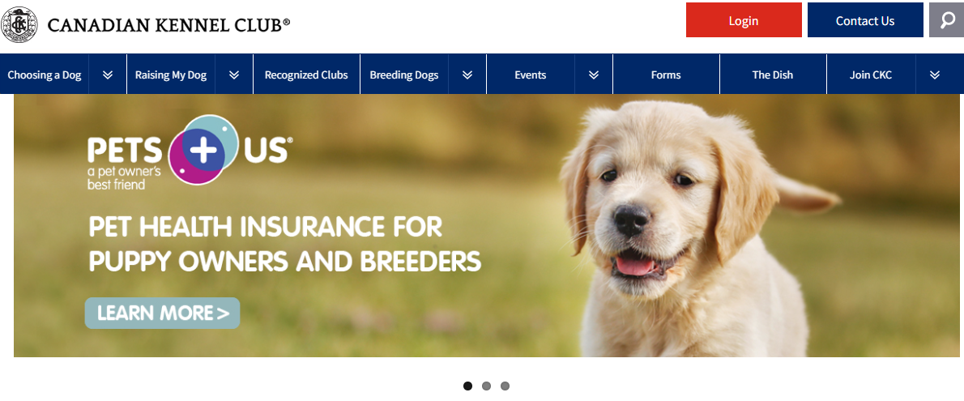
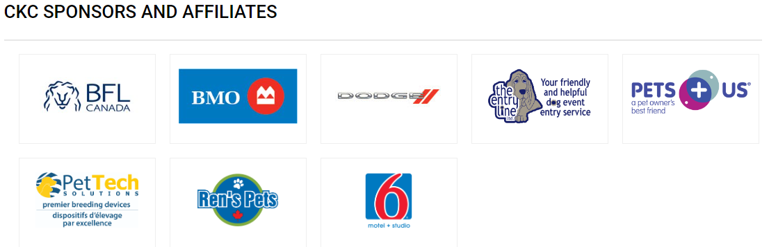

Slide 26

Questions?

